Slide 1

Modeling Exam Scores of Students
Predicting student performance using behavioral, environmental, and parental factors
Notes:
Kate: Hi, we’re group 3, Byron, Kate and Yang and we did our project on exam scores of students.

Slide 2




Research Questions
Strongest Predictors
Combined Effects
Which factors have the strongest relationship with exam score?
Do behavioral, environmental, and parental predictors remain significant when evaluated together?
Model Complexity
Outlier Influence
Do interaction or nonlinear effects improve prediction accuracy?
Are there outliers influencing the results?
Notes:
Byron: We began by identifying what the goal of this project is. We wanted to assess which factors have the strongest relationship with exam scores so that students, educators, and policymakers can better target efforts and resources to improve student academic success.
We also wanted to dig in to if any factors had combined effects or non linear relationships and if any outliers were influencing the results.

Slide 3
Dataset Overview
6,607
Response Variable
Exam Score (%) — continuous outcome ranging from 0 to 101
Student Observations
Predictor Categories
Large synthetic sample for robust analysis
Behavioral: hours studied, attendance, sleep hours, previous exam scores, physical activity
19
Support: tutoring sessions, parental involvement, access to resources, parental education levels
Contextual: income level, disabilities, school type
Predictor Variables
Mix of numeric and categorical data
Notes:
Yang: Our dataset was synthetically created and posted to Kaggle for educational and experimental analysis. Our response variable chosen is exam score and the observed variables fell into behavioral, support, and contextual categories.

Slide 4
Data Structure - Categorical
N
N Missing
Levels
Access To Resources
6607
0
3
Extracurricular Activities
6607
0
2
Motivation Level
6607
0
3
Internet Access
6607
0
2
Family Income
6607
0
3
Teacher Quality
6607
78
3
School Type
6607
0
2
Peer Influence
6607
0
3
Learning Disabilities
6607
0
2
Parental Education Level
6607
90
3
Distance from home
6607
67
3
Gender
6607
0
2
Notes:
Yang: Our categorical variables include access to resources, extracurricular activities, motivation level, income, school type, and more. Some variables, like teacher quality and parental education, have missing values, but the overall structure still supports regression. These variables allow us to capture environmental and contextual factors that may affect performance.

Slide 5
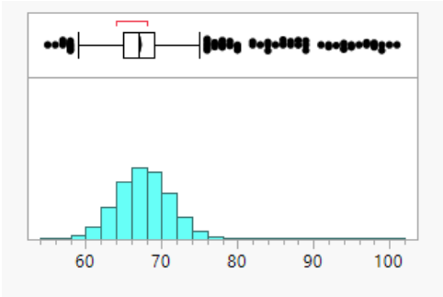
Data Structure - Categorical
Response Summary Statistics
Mean: 67.24
Std Dev: 3.89
Std Err Mean: .05
N: 6607
N Missing: 0
Notes:
Kate: Our response variable, exam scores, have a mean of about 67 with a standard deviation of around 4, which is fairly close together. We can see a few clusters of higher performing students, as well.

Slide 6
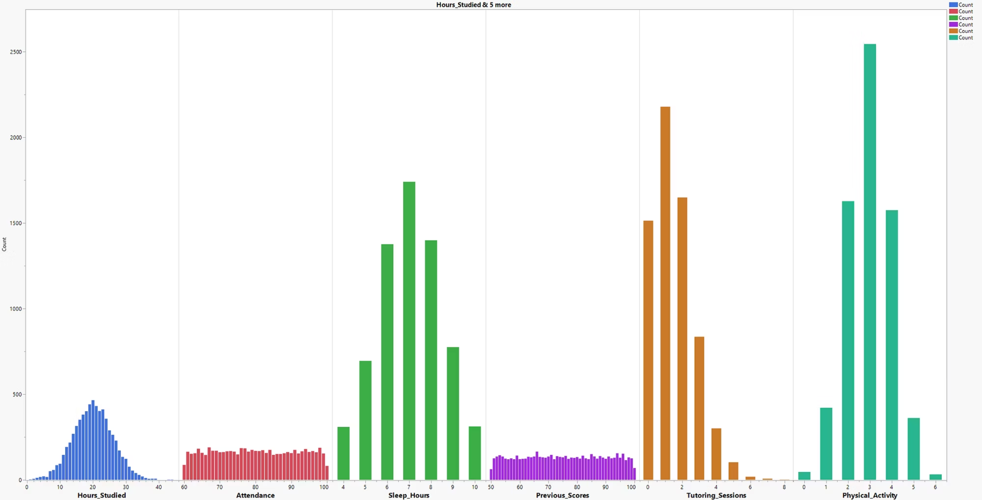
Notes:
Kate:.
Looking at the distributions of the numerical data, a few things stand out right away:
Hours studied is centered around 20 hours per week, but with a small group of heavier studiers at the high end.
Attendance is pretty evenly spread between about 60% and 100%.
Sleep hours are very symmetrical around seven hours, which fits expectations for a typical student.
Previous exam scores also appears to be fairly evenly distributed in a large range of 50-100%.
Tutoring sessions are skewed right, with most students having little to no tutoring and only a few receiving a larger than average number of sessions.
Physical activity is fairly normally distributed around about three and a half hours per week.

Slide 7
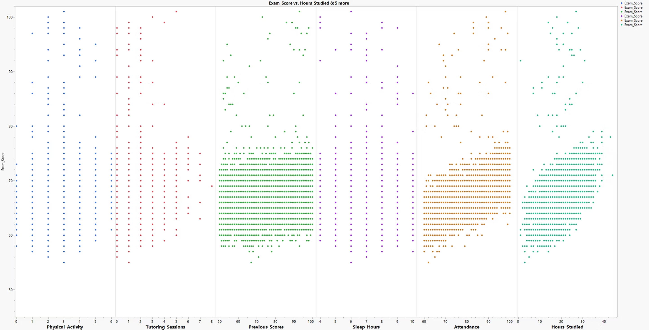
Notes:
Kate: Next, we looked at scatter plots of our numerical data vs exam scores. We can see some signs of strong linear relationships for hours studied, previous scores, and attendance.

Slide 8



EDA Takeaways
Strong Positive Relationships
Hours studied, attendance, and previous scores show clear positive correlations with exam performance.
Weaker Patterns
Sleep and physical activity weaker or noisier relationships requiring careful modeling.
High-Achieving Outliers
Identified a distinct group of exceptional performers worth investigating separately.
Notes:
Byron:
Our analysis revealed three patterns.
First, Hours studied, attendance, and previous scores all appear to have strong positive relationships with exam performance.
Second, variables like sleep and physical activity showed weaker or noisier relationships.
Third, we began to see a cluster of high achieving outliers worth examining later.

Slide 9




Modeling Approach
Variable Selection
Stepwise selection method applied to identify most important predictors while avoiding overfitting.
Three Regression Models
Main-effects linear model, interaction model, and quadratic model to test different complexity levels.
Assumption Validation
Checked normality, homoscedasticity, leverage, and outlier influence to ensure model validity.
Cross-Validation
80/20 train-test split to assess model generalization and prevent overfitting to sample data.
Notes:
Yang - We approached modeling systematically. We first used stepwise selection to narrow down the most important predictors while avoiding overfitting. We used the all possible models function to identify the most balanced number of variables to include, Then we compared three models: a main-effects model, a two-way interaction model, and a second order model. We validated model assumptions using residual diagnostics and influence measures. Finally, we used an 80/20 cross-validation split to assess how well the model would generalize to new students.

Slide 10
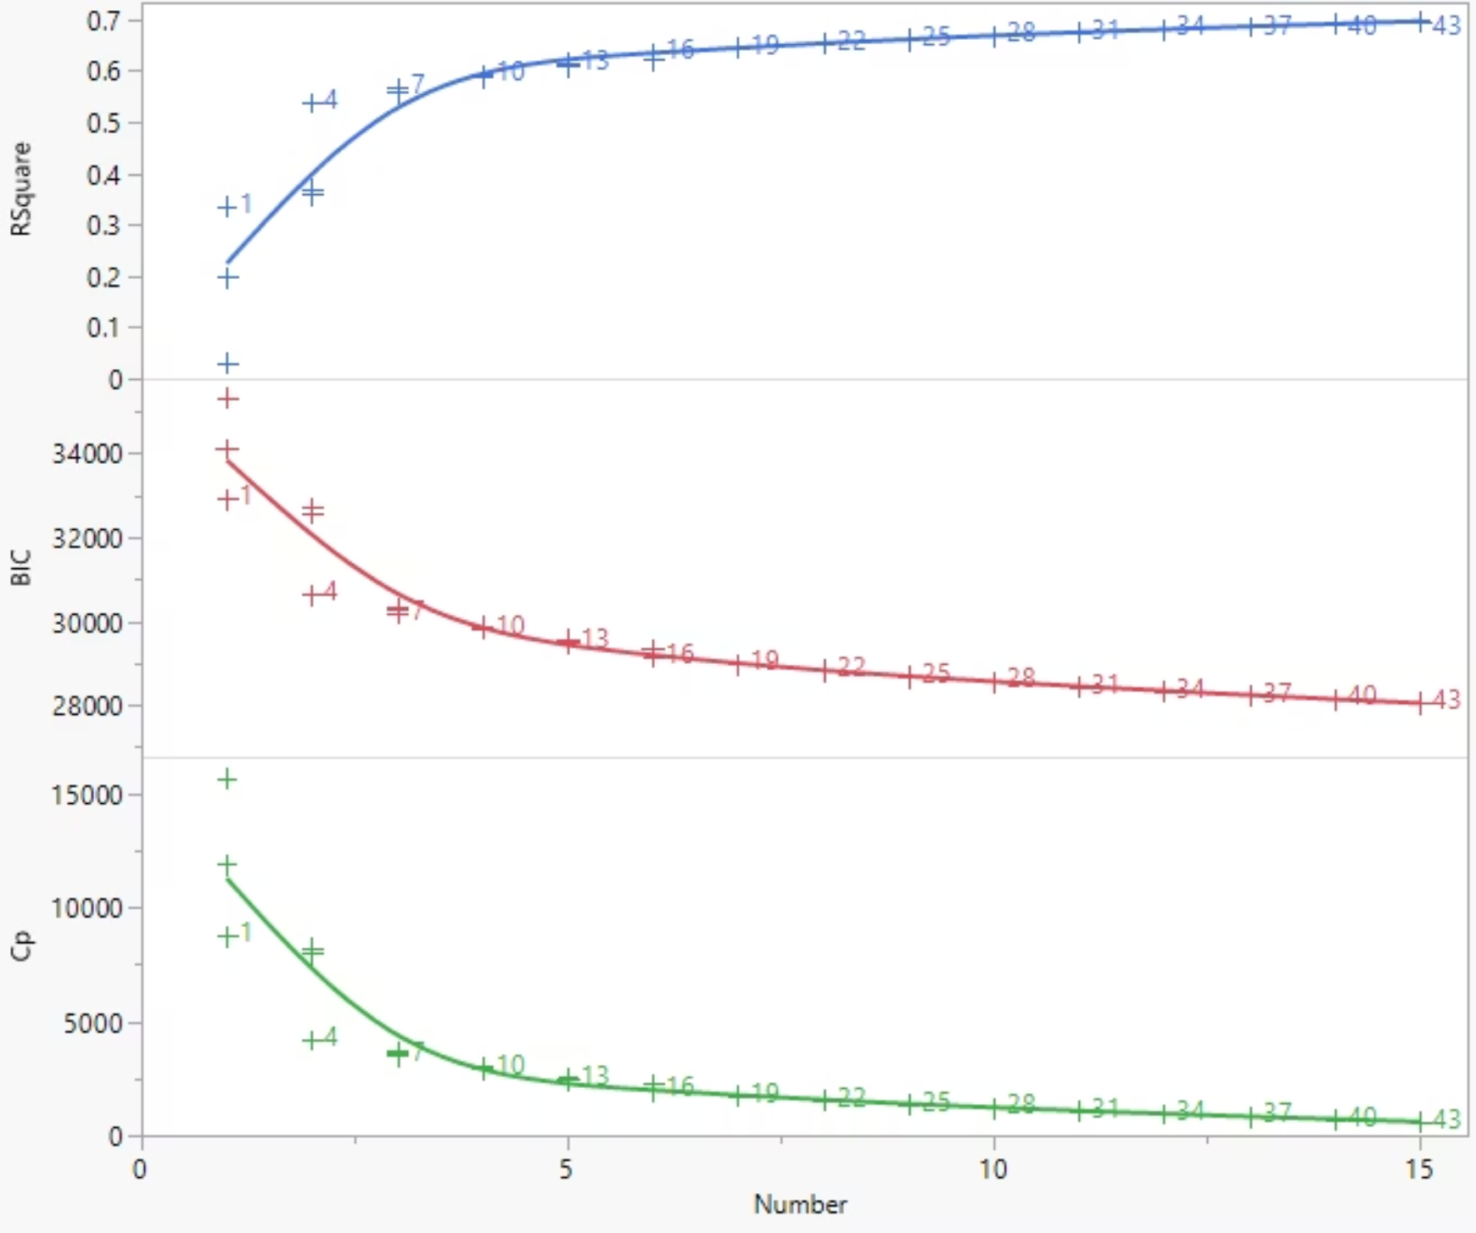
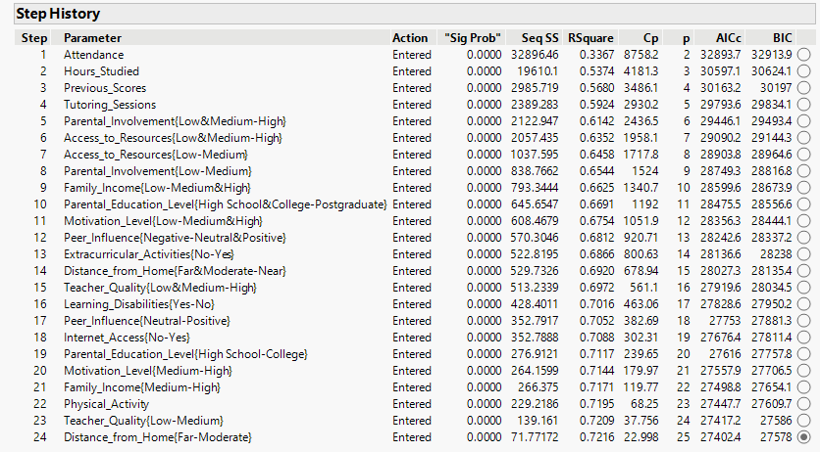
Variable Selection
Notes:
Kate: We began with all 19 predictors in a stepwise regression. Stepwise kept almost every variable. To avoid building an unnecessarily large model, we also ran all possible models and compared R-squared, Cp, and BIC values. These metrics showed a clear elbow point around four to six predictors, meaning extra variables added little value. To determine if the variables that had missing data were affecting this, we ran the stepwise selection again without the observations with missing values and got the same results. Our selected variables were then attendance, hours studied, previous scores, tutoring sessions, parental involvement, and access to resources.

Slide 11
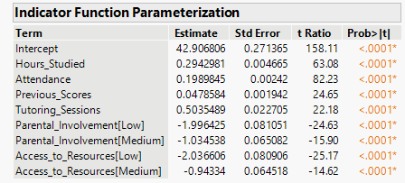
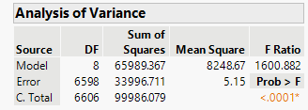
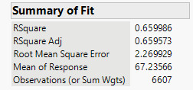
Model 1: Main-Effects Linear Model
Selected Predictors
Model
Hours studied
Attendance percentage
Previous exam scores
Tutoring sessions
Parental involvement
Access to resources
Hypothesis Testing
Notes:
Byron: Our first model uses the six predictors, with dummy variables created for the categorical variables. All terms appeared to be statistically significant to this model, and this model explains about 66% of variation in exam scores.

Slide 12
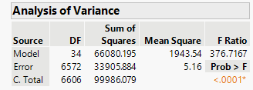
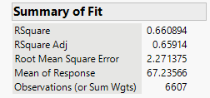
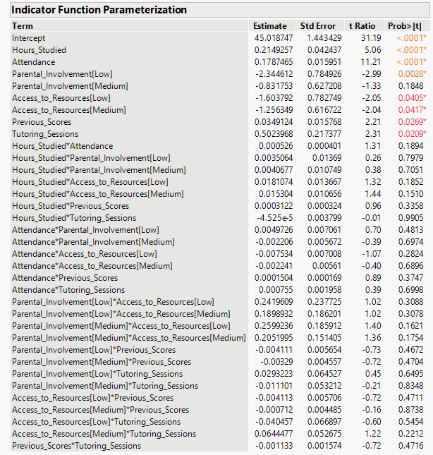
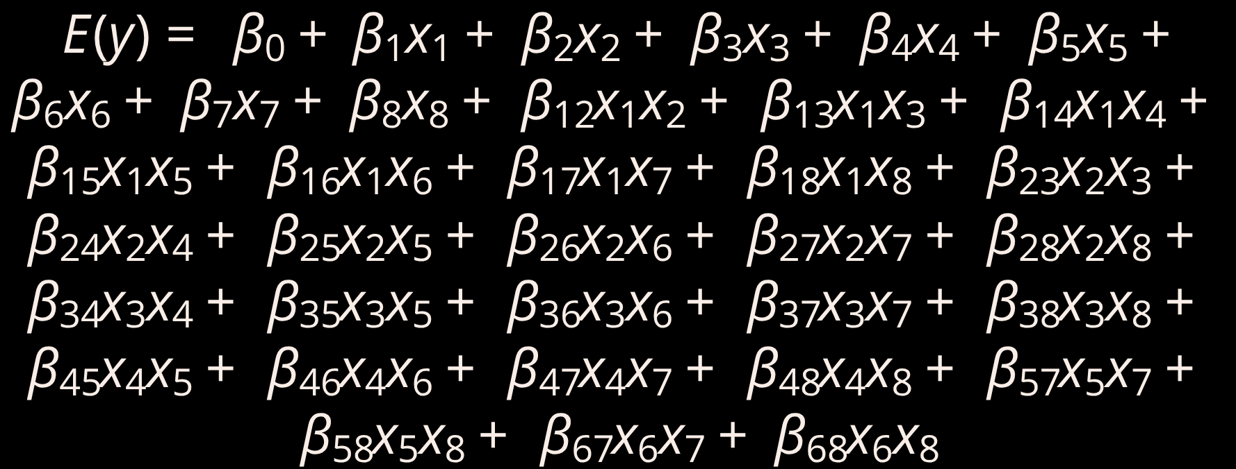
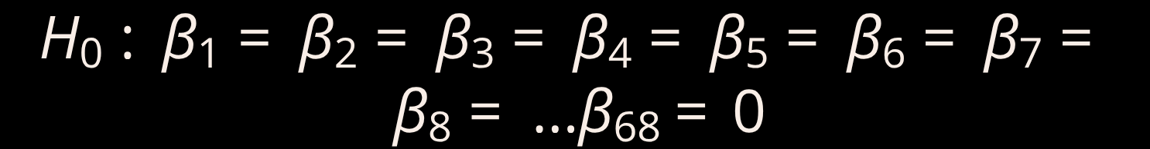
Model 2: Two Way Interaction Model
Model
Hypothesis Testing
Notes:
Yang: In the second model, we added all possible two-way interactions. The goal was to test whether certain effects depend on each other, for example, whether tutoring is more effective for students with lower attendance. However, the interaction model didn’t improve performance. Adjusted R-squared stayed flat, MSE increased slightly, and most interactions were insignificant.

Slide 13
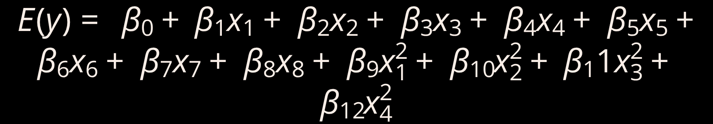
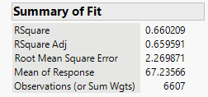
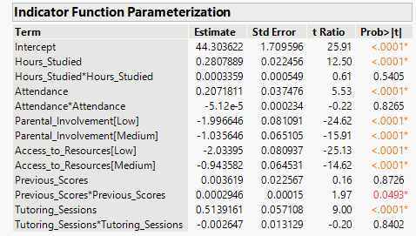
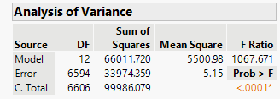
Model 3: Second Order Model
Model
Hypothesis Testing
Notes:
Kate: Our third model introduced higher order terms to check for nonlinear patterns. Again, this added complexity did not improve the model. Adjusted R-squared did not increase, and MSE stayed essentially the same. This suggests that exam performance responds to these predictors in a mostly linear way.

Slide 14



Model Comparison Summary
Model
MSE
Adj. RSquare
s
F Ratio
p-value
1
5.15
.66
2.27
1600.882
<.0001
2
5.16
.66
2.27
376.7167
<.0001
3
5.15
.66
2.27
1067.671
<.0001
Best Balance
No Added Value
Final Selection
Model 1 achieves optimal balance of fit and interpretability without unnecessary complexity.
Both interaction and quadratic models fail to improve prediction—partial F-tests confirm this.
Model 1 selected as final model for interpretation and practical application.
Notes:
Byron: When we compare the three models side by side, we see that Model 1 provides the best combination of fit and simplicity. All three models are statistically significant overall, but neither interactions nor quadratic terms provide added predictive value. Partial F-tests confirm that adding complexity is unnecessary. So we selected Model 1 as our final model for interpretation.

Slide 15
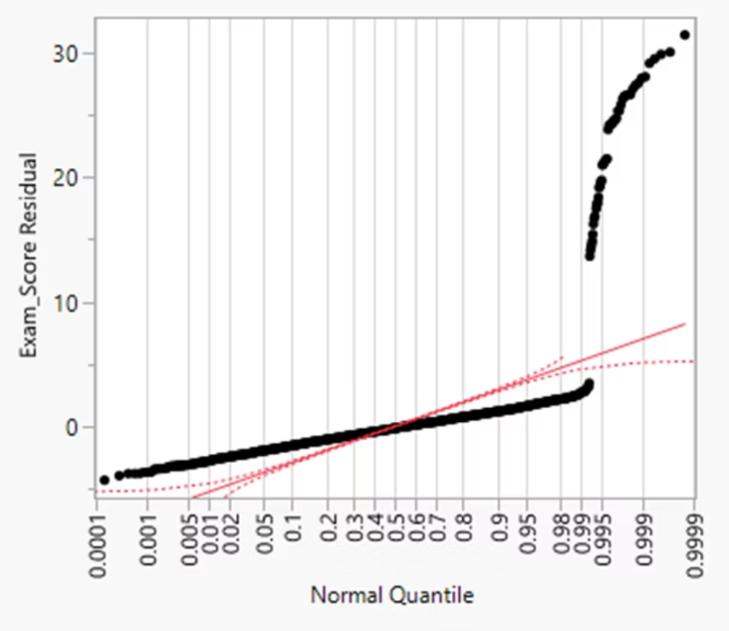
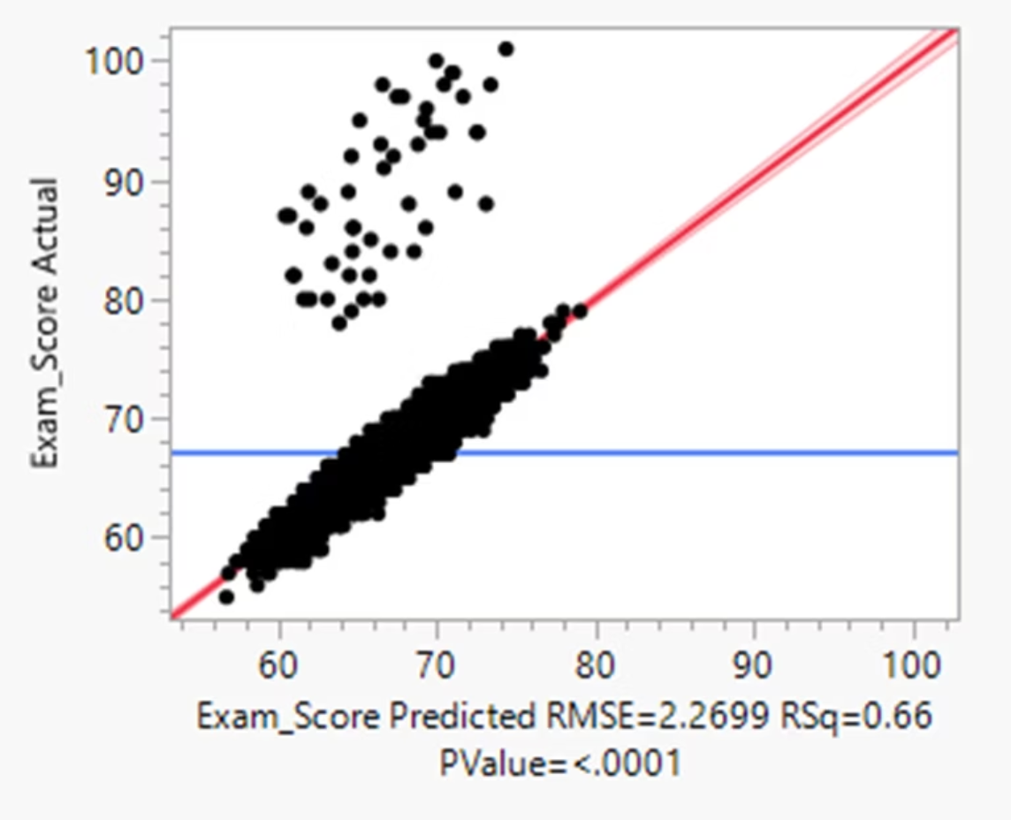
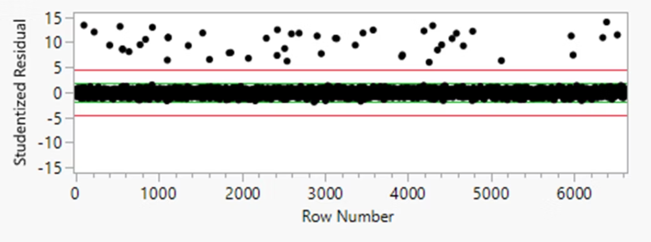
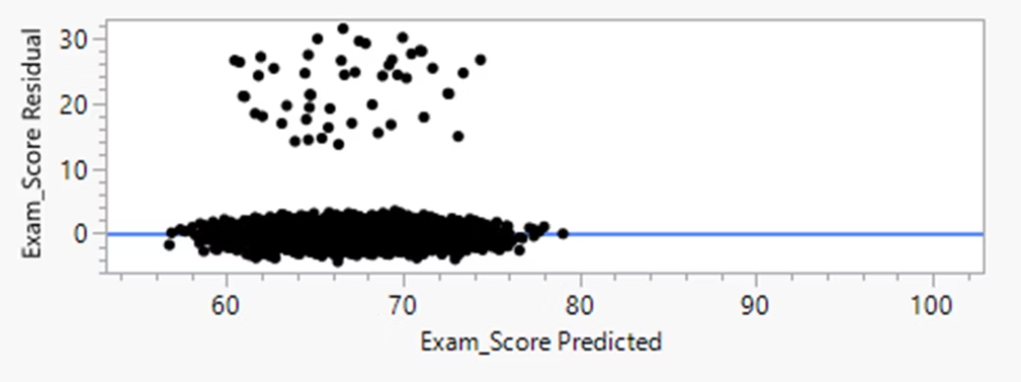
Model Diagnostics
Notes:
Byron: Our diagnostics showed that the residuals were not following the assumption of normality and identified 50 extreme outliers with studentized residuals between 6 and 14 standard deviations from their predicted values. Most of these students scored between 78 and 101, meaning the model consistently underpredicted their performance.

Slide 16
Outlier Detection & Analysis
50
6-14
78-101
Extreme Outliers
Studentized Residuals
Score Range
Students identified with unusual residuals
Standard deviations from predicted
Mostly high-achieving students
Notes:
Kate: This pattern in our outliers suggests the presence of missing variables not captured in our current predictor set. Potential factors include learning strategies, courses taken, course load or other factors beyond what our data captures. These students represent a distinct subgroup whose success isn't fully explained by the measured behavioral and environmental factors.

Slide 17
Outlier Influence Assessment
Low Leverage
Not unusual in predictor space
Cook's D < 1
Not influential on coefficients
Important Subgroup
Represent meaningful pattern
Conclusion: The outliers do not distort model or invalidate our regression estimates. However, they do represent an important subgroup of high achievers whose success isn't captured by our current variables, warranting further investigation.
Notes:
Kate: Even though these students are extreme in performance, they don’t have extreme predictor values. Their leverage values fall below the 2h-bar cutoff, and all Cook’s Distance values are well under 1. This means they are not influential. We also wanted to confirm that the observations were not made outliers by our removing variables, so we ran a model with all variables as well and found this same cluster of students still outside the range of their peers. The takeaway is that our model is stable, but it’s missing a factor that explains higher than average performance.

Slide 18
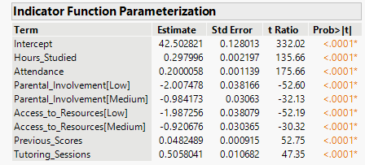
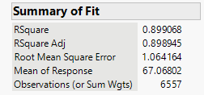
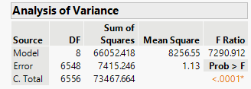
Refitting the Model
Model Improvement
0.90
New Adjusted R²
Dramatic improvement from 0.66
Notes:
Yang: When we removed the 50 outliers and refit the model, the adjusted r squared jumped from .66 to about .90. Mean Square Error reduced to 1.13 and F ratio increased to 7290.912.

Slide 19
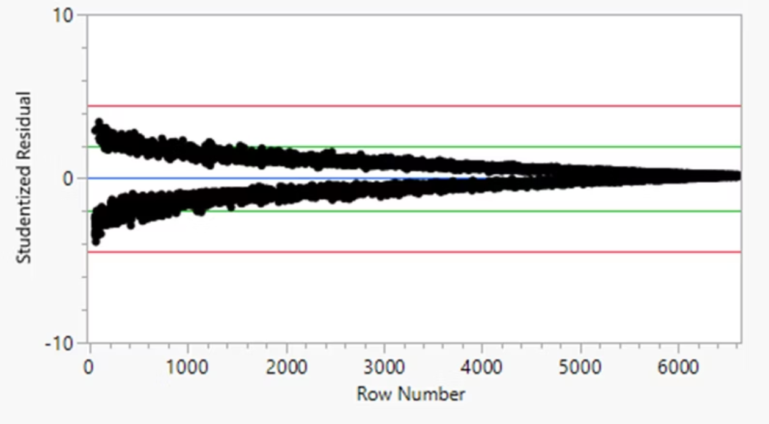
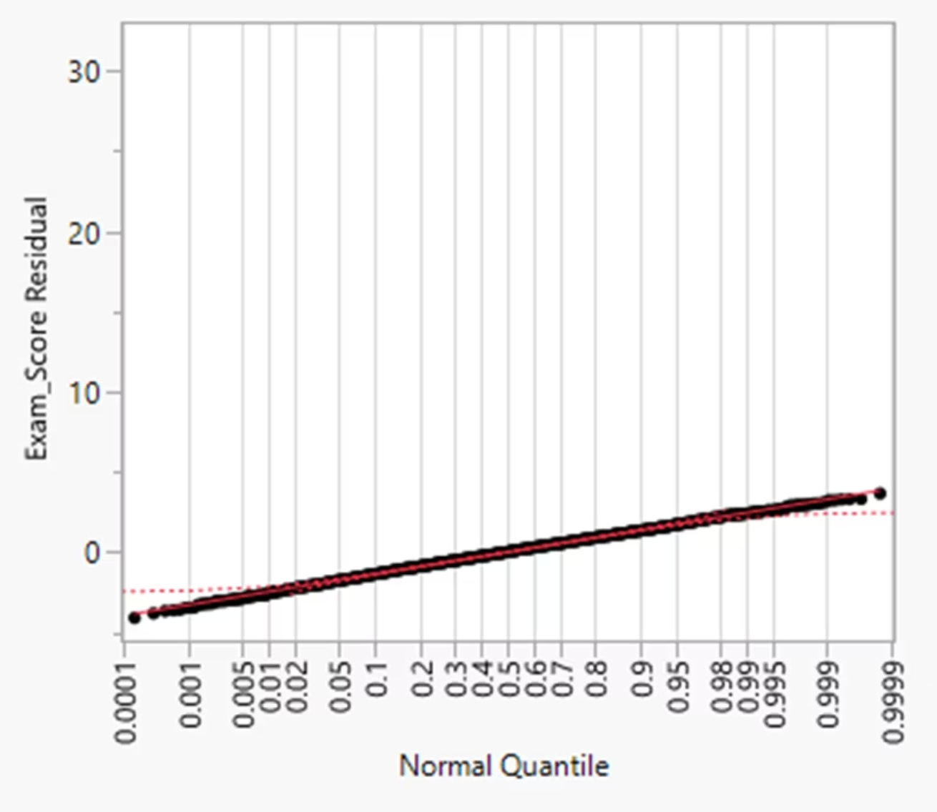
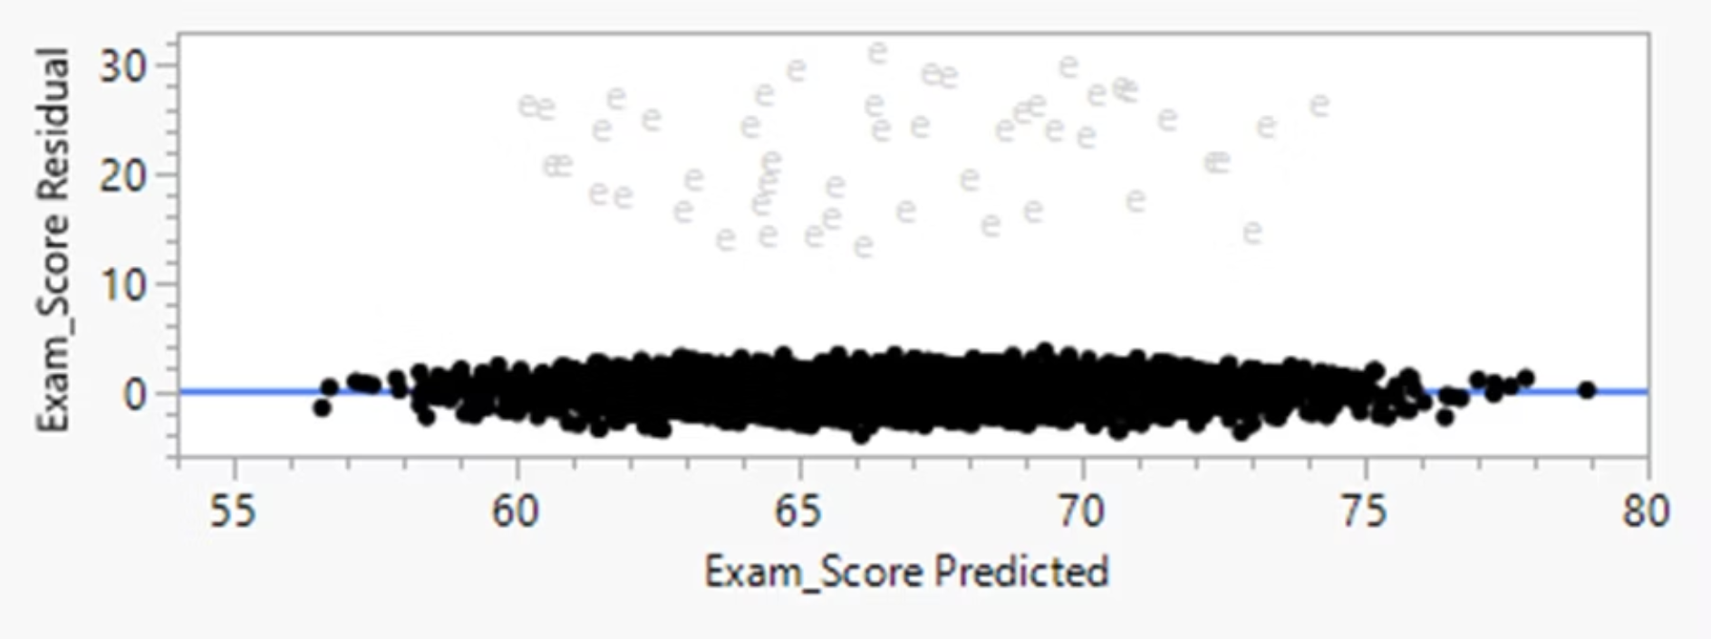
Diagnostic Improvements
Residuals more normally distributed
Greatly reduced skewness
Homoscedasticity substantially improved
Clearer linear patterns
Notes:
Kate: The residuals looked much more normal, skewness dropped, and homoscedasticity improved. This confirms that Model 1 fits the average student very well.

Slide 20
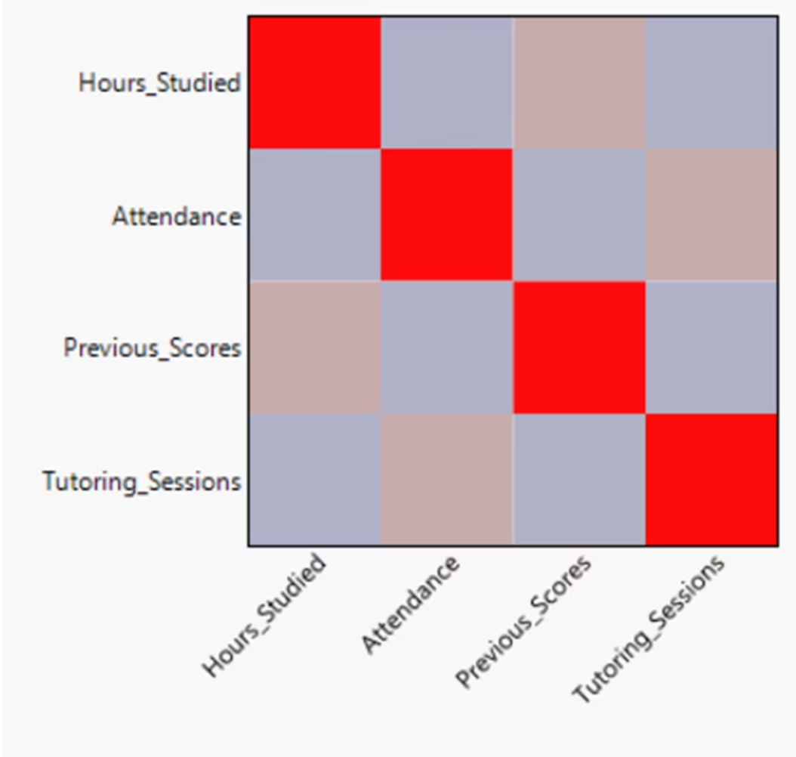
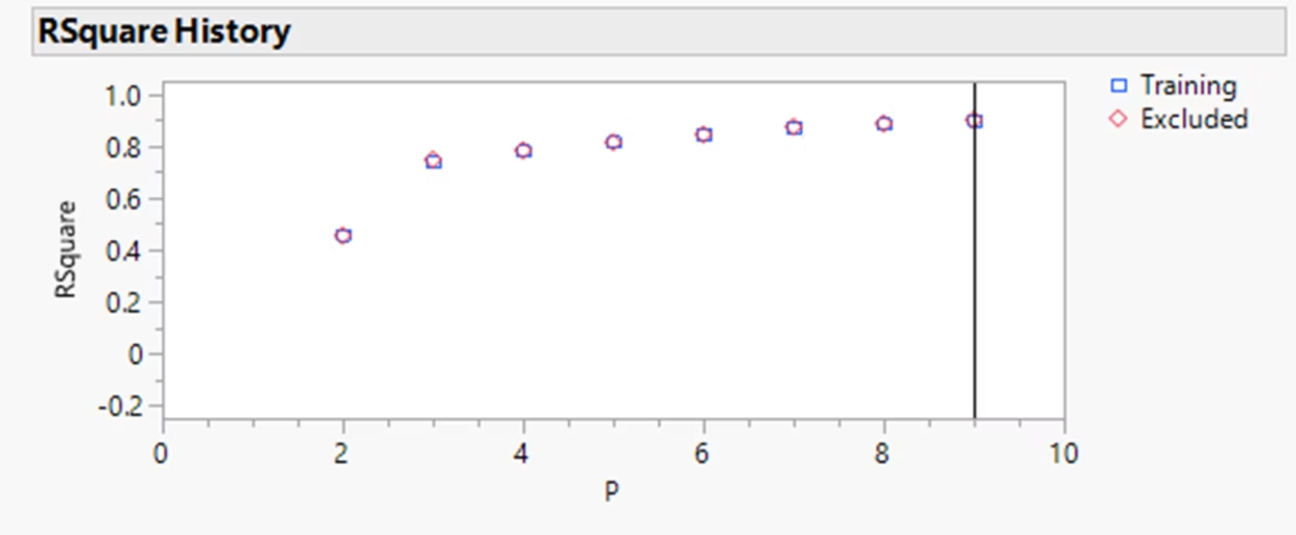
Cross-Validation & Diagnostics
Notes:
Byron - Cross validation confirmed that our refit model generalizes well. Training and testing MSE were very similar, showing no signs of overfitting. Diagnostic checks such as correlation analysis also showed no multicollinearity problems. Altogether, these results support Model 1 as a strong and reliable model for predicting exam performance.

Slide 21
Final Conclusions
Behavioral Factors
Support Factors
Previous exam scores
Parental involvement, Tutoring sessions, and access to resources have meaningful but smaller effects on outcomes.
Hours studied
Attendance
High Achievers
Outliers represent high achieving students not fully explained by measured variables.
Notes:
Yang: To summarize: previous exam scores, hours studied, and attendance are the strongest predictors of performance. Support factors like parental involvement, access to resources, and tutoring also matter, but have smaller effects.
Byron: The outliers highlight high performers whose success isn’t captured by our observed variables.
Kate: Students who have had low previous exam scores can be targeted for tutoring and resource programs, rewarding good attendance can drive students to have improved test scores, and students can dedicate more time studying to achieve academic success. Further study should also be conducted to try to isolate the driving factor for students who perform exceptionally well.

Slide 22
Thank You!

